Slide 1
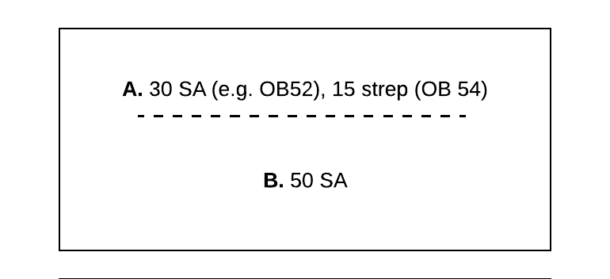
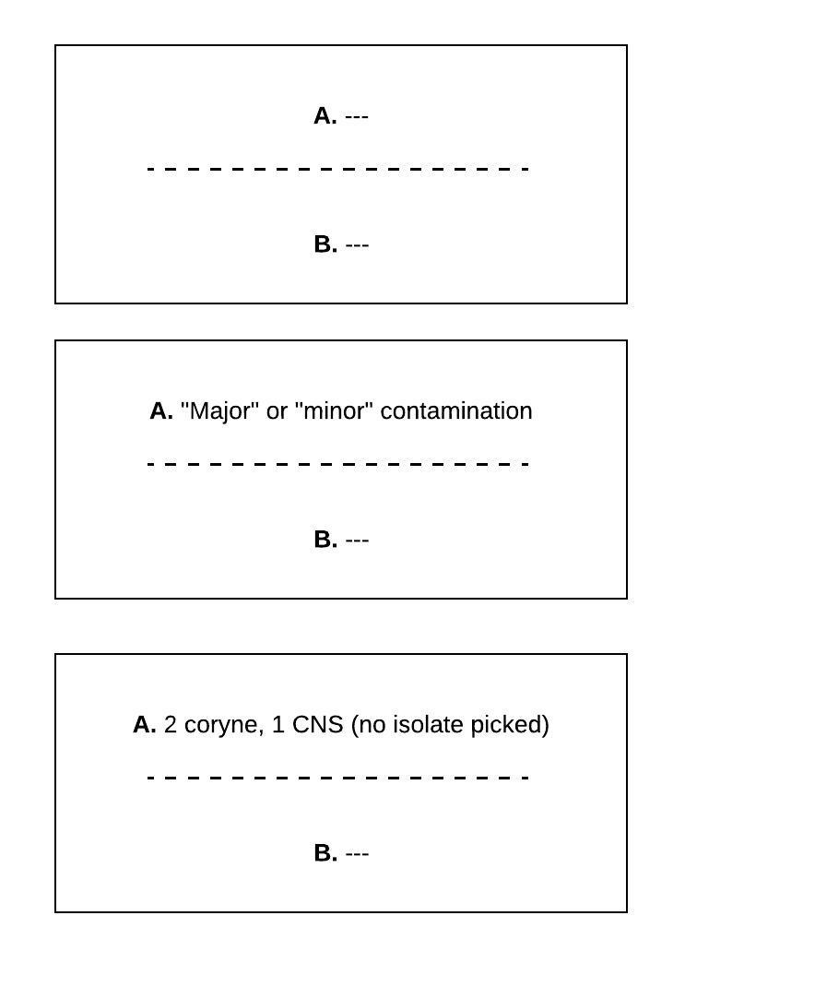
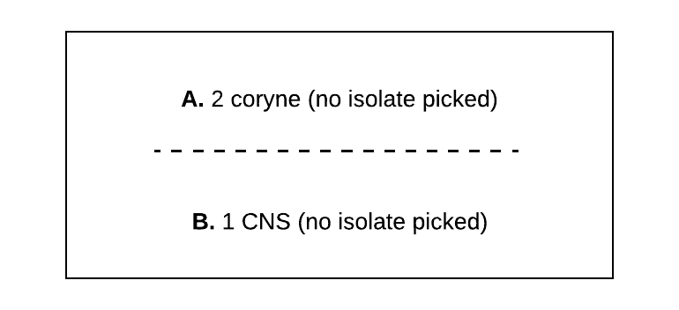
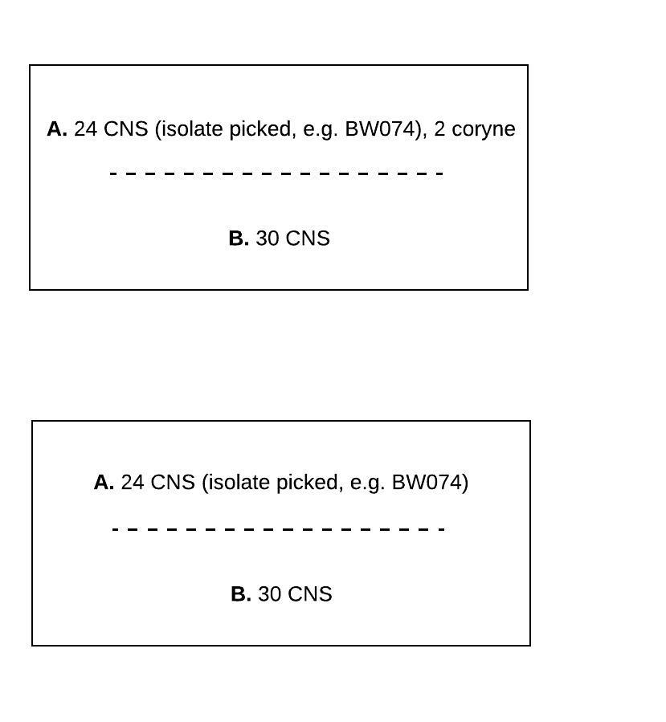
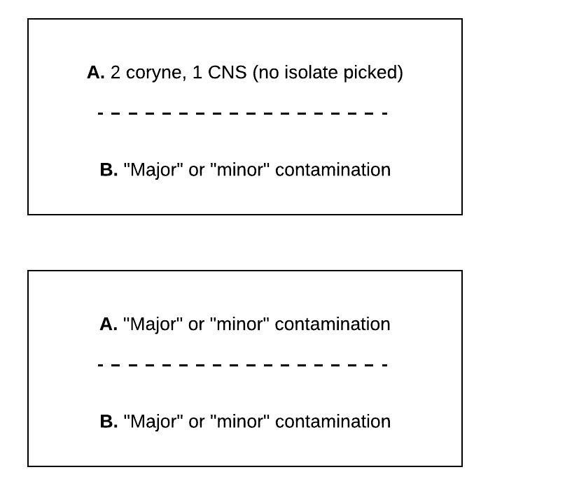
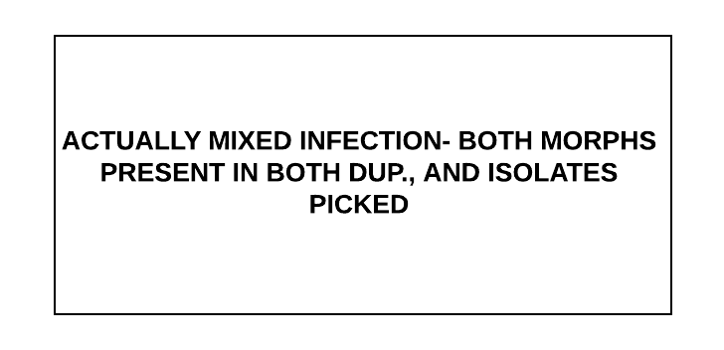
“IMI no”
“Contaminated”
29
≤2 CFU of each morph in BOTH dup. NOT SAME ORG
3
6
1
“contam” if ≥3 morphs
“IMI yes”
4
7
2
≤2 CFU of each morph in ONE dup, NG in other
5
8
27

Slide 2
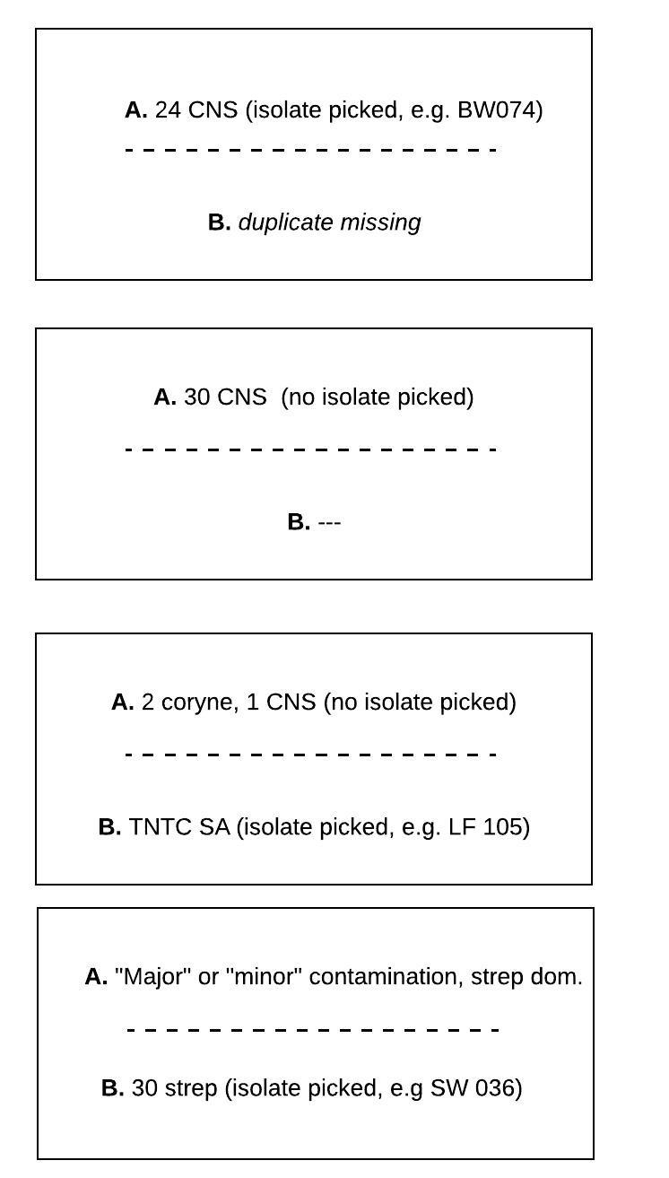
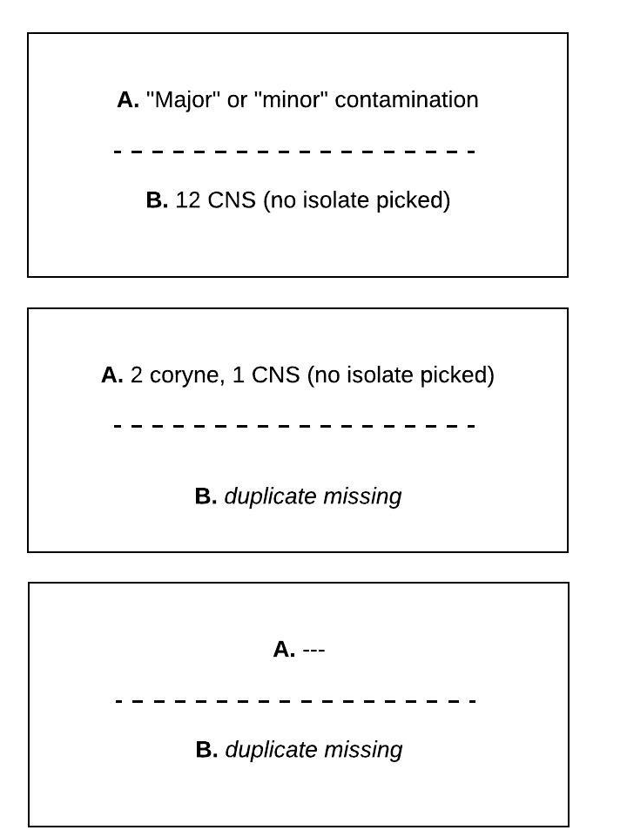
“Other”
≥3 CFU of 1 morph in one dup YES in parallel
9
≥3 CFU of 1 morph in one dup YES in parallel
13
≥3 CFU of 1 morph in one dup YES in parallel
10
≥3 CFU of 1 morph in one dup YES in parallel
14
11
15
12

Slide 3
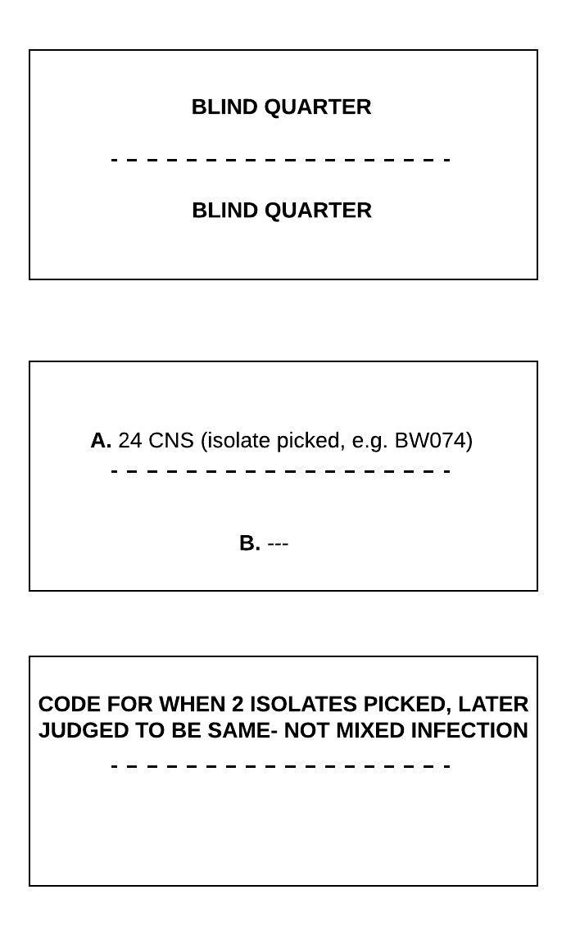
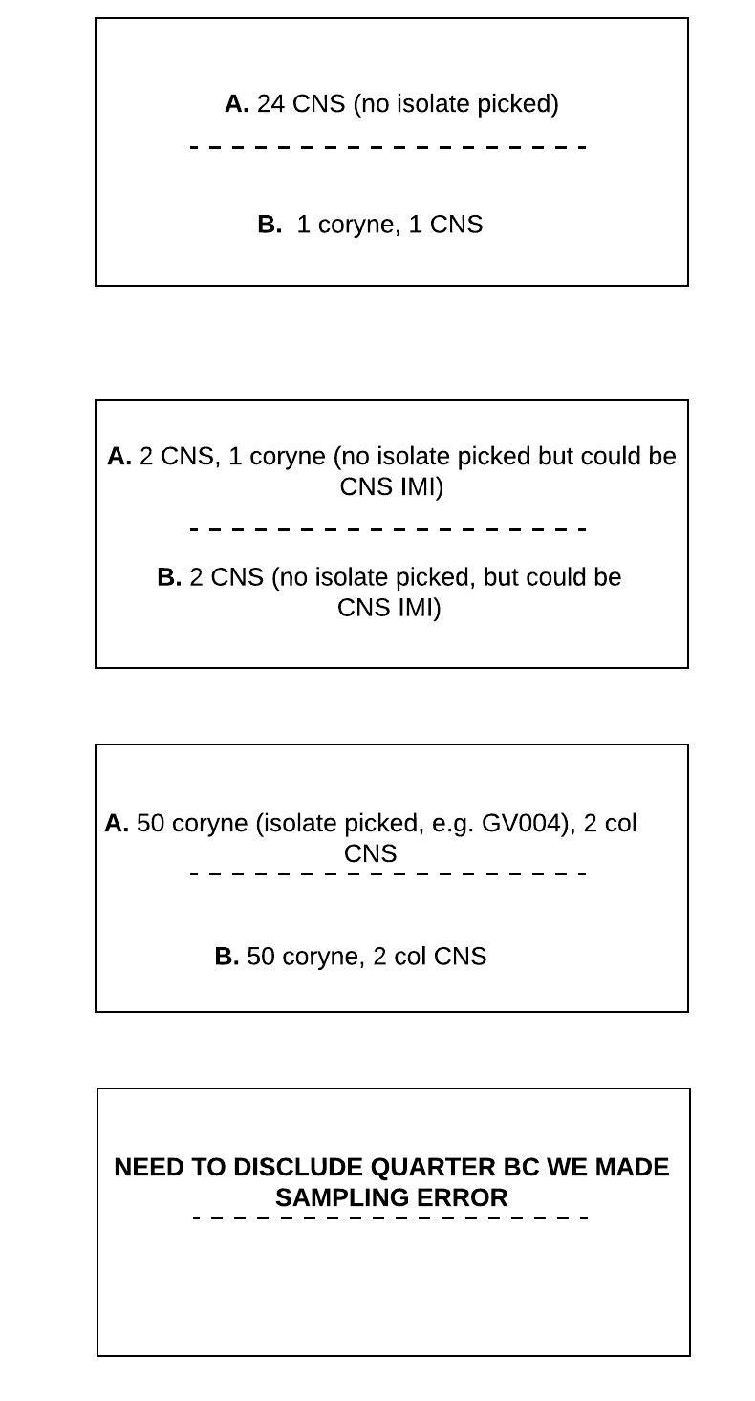
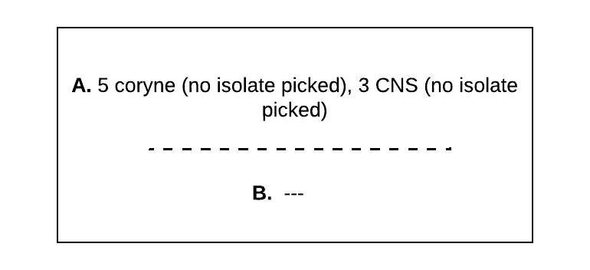
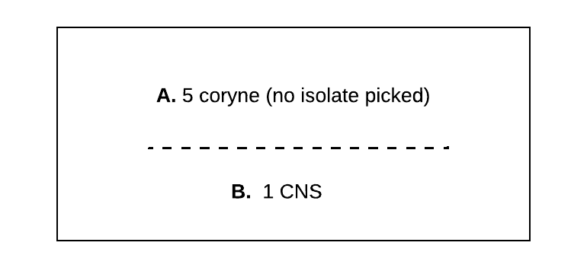
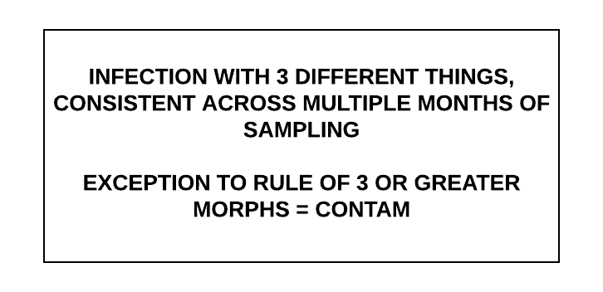
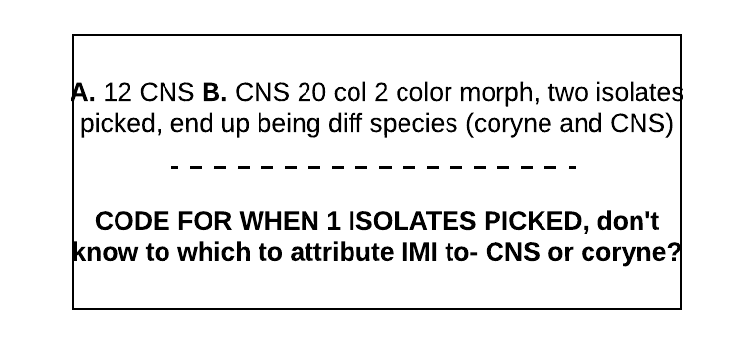
“Other”
TECHNICALLY yes IMI in series, but missed picking isolate; ≥3 CFU of 1 morph in at least one dup
≥3 CFU of 1 morph in one dup YES in parallel, MIXED
16
19
25
≥3 CFU of 1 morph in one dup YES in parallel
≤2 CFU of each morph in both dup, NSG? TECHNICALLY IMI in series, missed picking isolate
17
20
≥3 CFU of 1 morph in one dup YES in parallel
23
21
18
24
26
22

Slide 4
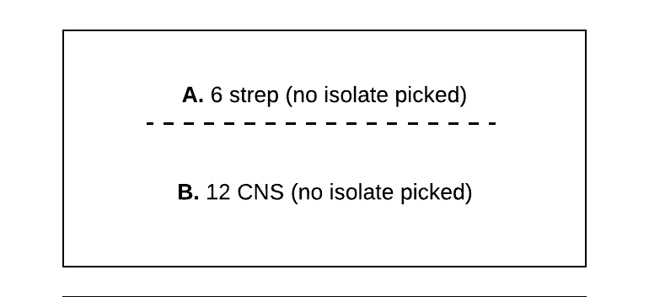
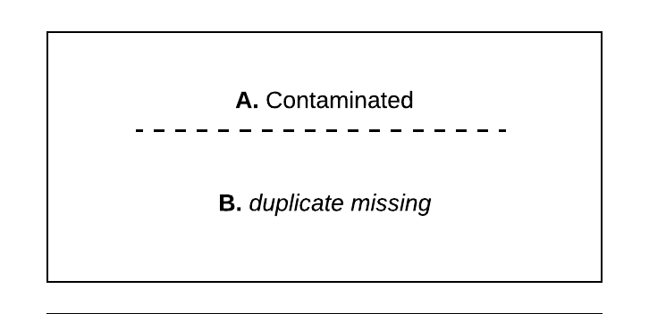
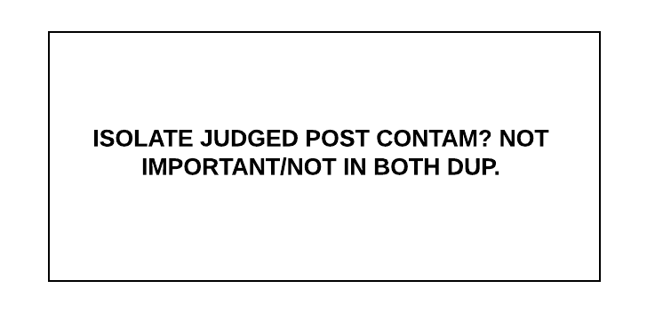
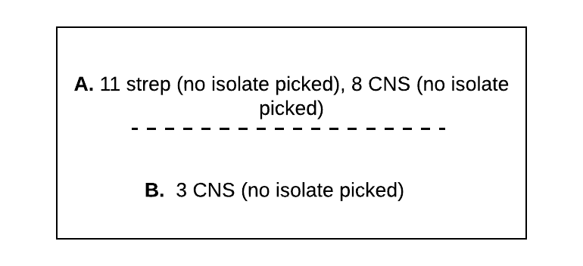
“Other”
28
30
31
32

